Slide 1
Customer Behavior Analysis
Presented by
Priyadharshini S

Slide 2
AGENDA
Understanding the problem
Objective and Datasets
Customer Journey and Engagement Analysis (SQL)
Customer Review Analysis (SQL & Python)
Marketing Effectiveness (SQL)
Business Recommendations

Slide 3
PROBLEM STATEMENT ShopEasy, an online retail business, is experiencing a decline in customer engagement and conversion rates, despite investing heavily in marketing campaigns. The company has observed:
Reduced Customer Interactions: Fewer customers are engaging with the website and marketing content.
Decreased Conversion Rates: A decline in the percentage of site visitors making purchases.
High Marketing Expenses: Increased spending on digital marketing but without a proportional increase in revenue.
Customer Feedback Gaps: Poorly understood customer preferences due to lack of structured feedback analysis.
To address these challenges, ShopEasy's Marketing and Customer Experience teams have reached out for a data-driven solution that analyzes customer behavior, reviews, and journey patterns using SQL and Python.

Slide 4
OBJECTIVE ShopEasy is struggling with low customer engagement, poor conversion rates, and ineffective marketing strategies. The business needs a data-driven approach using SQL and Python to analyze:
Customer journey behavior → Identify bottlenecks in the purchase process.
Customer reviews & feedback → Understand sentiment and satisfaction trends.
Marketing effectiveness → Measure the impact of engagement on conversion.
Product & demographic analysis → Identify high-performing products and customer segments.
The objective is to provide insights that will help ShopEasy improve engagement, optimize marketing spend, and boost overall conversions.

Slide 5
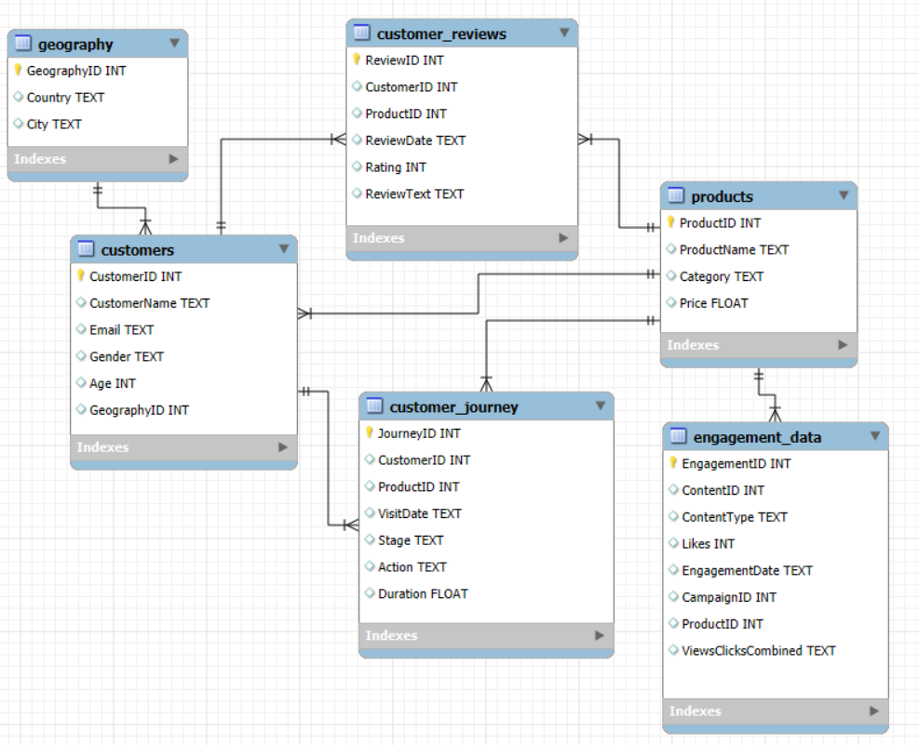
DATASETS

Slide 6
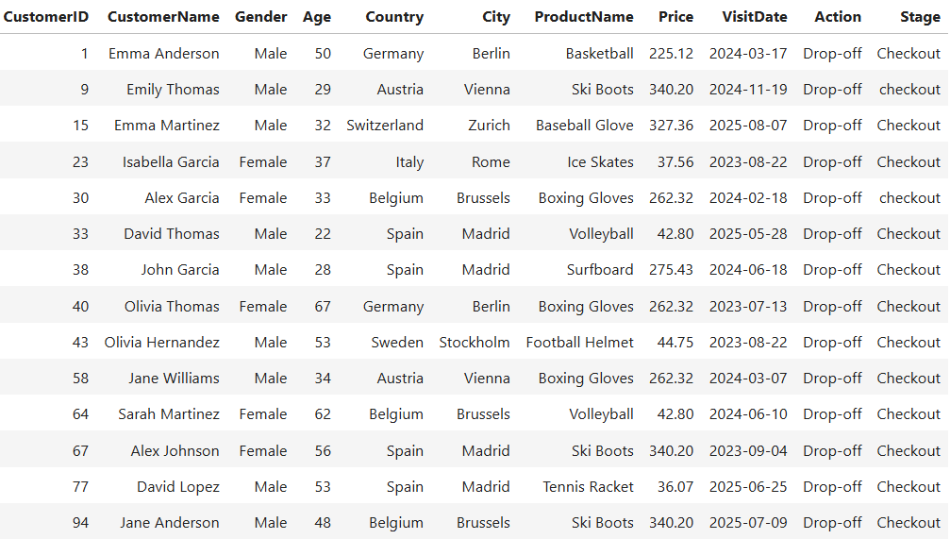
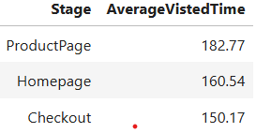
Customer Journey & Engagement Analysis (SQL)
Customers are dropping off during the check-out stage
Though customers spending time in visiting Home/ Product Pages, might face difficulty in converting sales
Suggestions:
Simplify the checkout process
Convenient payment options
Transparency about the delivery details and price details
Offer some deals/ include loyalty program

Slide 7
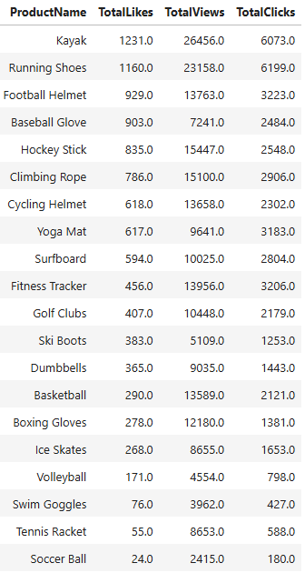
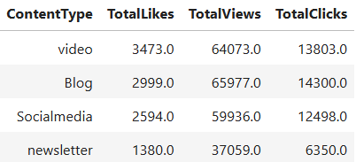
Engagement Analysis (SQL)
Through running campaigns, it is evident that Kayak is the most Liked and highly viewed
People are very much engaged in watching Videos and Blogs rather Social media or Newsletter

Slide 8
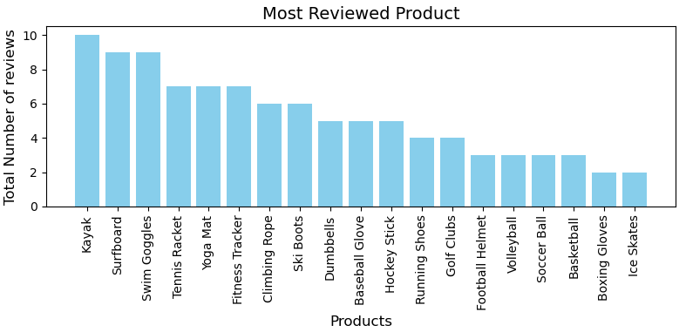
Customer Reviews Analysis (SQL & Python)

Slide 9
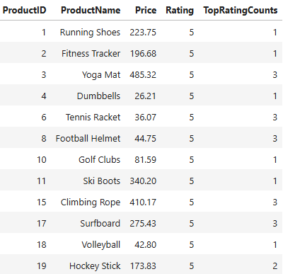
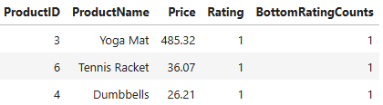
Customer Reviews Analysis (SQL & Python)
Products with less priced are most liked by the customers and they are also appreciated the quick delivery of the product.
Some customers are quite disappointed with the products Basket Ball, Dumbbell, Fitness Tracker and Tennis Racket.
Few customers felt price of the product could be cheaper
Top rated
Bottom rated

Slide 10
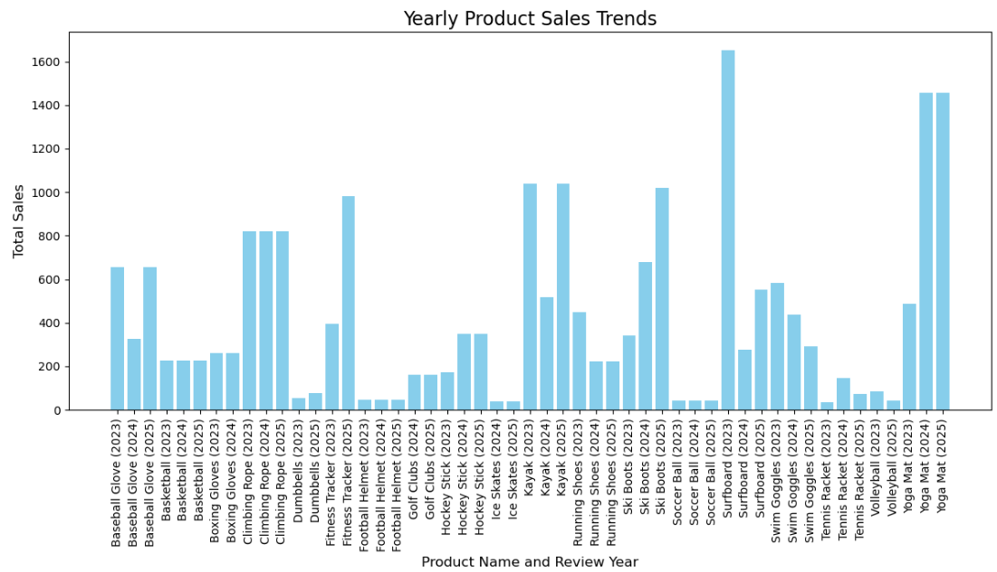
Review Trends vs Product Performance

Slide 11
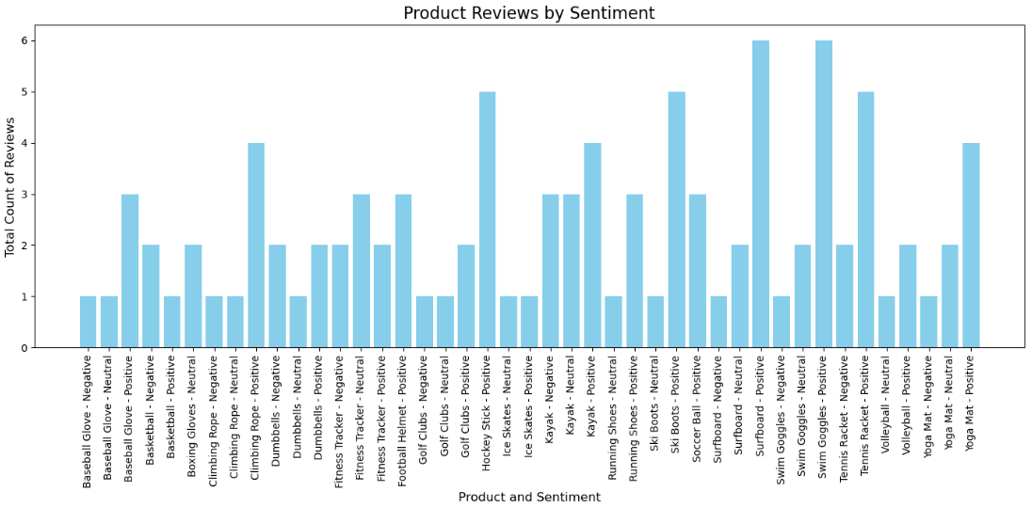
Basic Sentiment Analysis (SQL and Python)

Slide 12
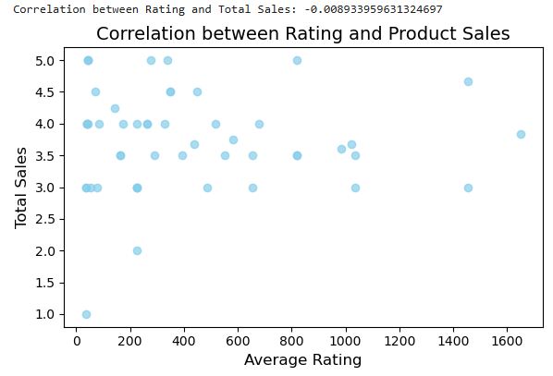
Correlate Review Trends and Product Performance
Review Feedback Analysis:
Pre-Purchase communication like guide on how to use the product
Improve quality of the product
Value of the price
Shipping aspects

Slide 13

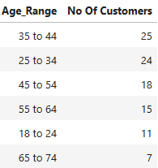
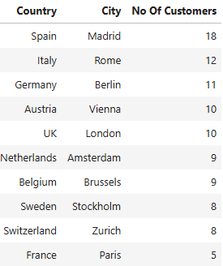
Demographic Analysis using SQL
Shopeasy contains 54% of female and 46% of male customers.
Most of the customers belongs to 25-44 age group.
Also, customers from Spain are more and there is a lot of improvement needed in marketing and focus more on France, Sweden, Switzerland.
Gender
Age
Region

Slide 14
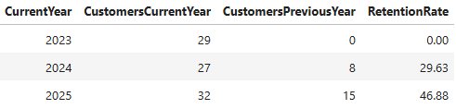
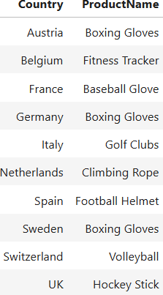
Marketing Effectiveness (SQL)
Though 46.88% of customers retained year on year, only 33.33% of retained customers purchased rather than first time purchases made by the new customers.
Below shown are the best performing products among the regions. Boxing Gloves is the one which is the most performing product in three of the regions.
Best performing Products
region-wise
Customers retention rate

Slide 15
Business Recommendations
Making the check-out process as easy as possible by having transparency about the shipping details, return policy and any additional cost if any.
Improve the Home page and Product Page to have successful conversion.
Enhance the product reviews to build trust and encourage customers to leave the reviews.
It would be great to have the clear instructions on usage of the product and improve quality for the highly priced product.
Be specific about the return or warranty policies for the mid or low rated products.
Frequent emails about the offers and deals, wishing on their birthdays in terms of communication.
Personalize and show the products based on the based on the customer visited records.
Display high value products by combining with the other products in the check-out page with some offers can turn into more sales.
Offer rewards and discounted prices as well as target promos and deals on some occasion and specific period.
Introduce Loyalty Program to add some points can encourage both regular and first time buyers.
Provide 24/7 Customer support through chats or emails to have good customer experience.

Slide 16
THANK YOU

